Slide 1

Ruby Language

Slide 2
About today…
Classes
Objects

Slide 3
Object-Oriented Programming
OOP is a programming paradigm based on the concept of "objects," which can contain data and code
Data is in the form of fields (often known as attributes or properties)
Code is in the form of procedures (often known as methods)

Slide 4
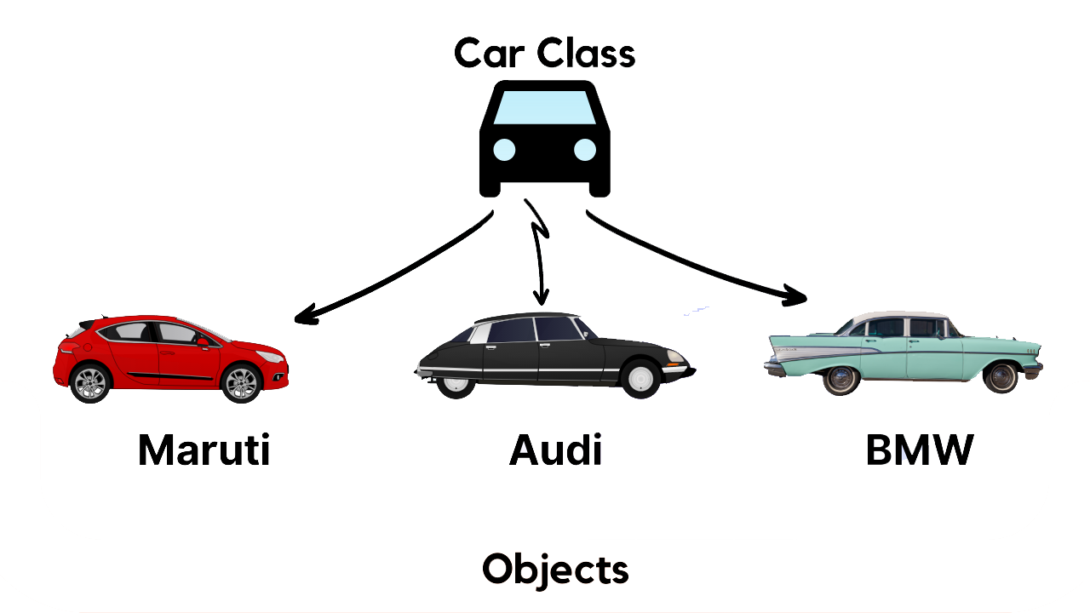
Classes and Objects
Class
A blueprint for creating objects. It defines a set
of attributes and methods that the created objects will have
Object
An instance of a class. It can have
its own attributes and can perform actions using its methods

Slide 5

Give real-world examples of classes and objects

Slide 6
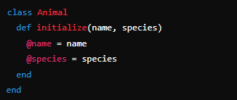
Creating Classes in Ruby
‘class Animal’ defines a new class named ‘Animal’
‘initialize’ is a special method called when an object is created
‘@name’ and ‘@species’ are instance variables

Slide 7
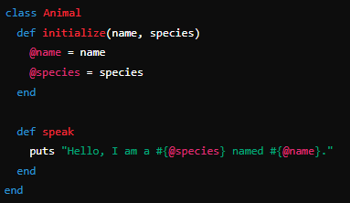
Defining methods in a Class
'def speak' defines a method named 'speak'
‘puts’ outputs a string to the console

Slide 8
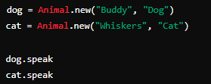
Creating Objects
‘Animal.new’ creates a new instance of the ‘Animal’ class.
‘dog’ and ‘cat’ are objects of the ‘Animal’ class.
Calling ‘speak’ on these objects invokes the ‘speak’ method.

Slide 9


Slide 10

What is a class in Ruby?
Which method is called when a new object is created in Ruby?
What does the @ symbol represent in Ruby?
How do you define a method in Ruby?
In Ruby, which keyword is used to define a class?
Which method would you use to output a string to the console in Ruby?

Slide 11
Task 1
Create a Person class with name, age, and job attributes. Define a method introduce that outputs a brief introduction.
Task 2
Create a Book class with title, author, and pages attributes. Define a method summary that outputs a summary of the book

